Slide 1

KHCC
AidConnect
A Smart, Human-Centered Donor and Patient Matching System for Cancer Financial Aid
Mallak Abu Sada · Maya Abu Aslahamat
Business Intelligence & Data Analysis · University of Petra · Supervised by Dr. Ayman M. Mansour
111
Patients
250
Donors
378
Matches
100%
Coverage

Slide 2
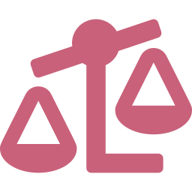



The Problem We Set Out to Solve
SLIDE 2 / 15
We sat with the caseworkers at KHCC. We found three gaps.
No fair scoring
No donor transparency
Slow, manual matching
Priority is set by judgement, not a formula. Nothing is consistent, nothing is auditable, and the same file can be ranked differently twice.
Donors give but never see where their money went or who it helped.
Pairing 250 donors with 111 patients across six programmes is done by hand, so high need patients are often missed on the waitlist.
KHCC AidConnect · Graduation Project Defense · Mallak Abu Sada & Maya Abu Aslahamat · 2025/2026

Slide 3
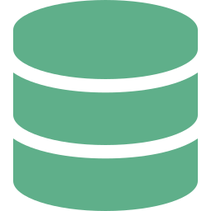

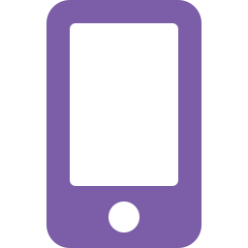

One App, Built on a Clear Pipeline
SLIDE 3 / 15
Three phases take us from raw data to a confident gift. Compliance is checked first, by design.
1
2
3
Prepare
Match
Deliver
Clean the data, then validate the Need Score with statistics.
Zakat Gate compliance checked first
The donor sees real impact, confirms, and gets a thank you.
▼
KNN Engine top 4 compatible patients
▼
Recommender ranked aid programmes
KHCC AidConnect · Graduation Project Defense · Mallak Abu Sada & Maya Abu Aslahamat · 2025/2026

Slide 4
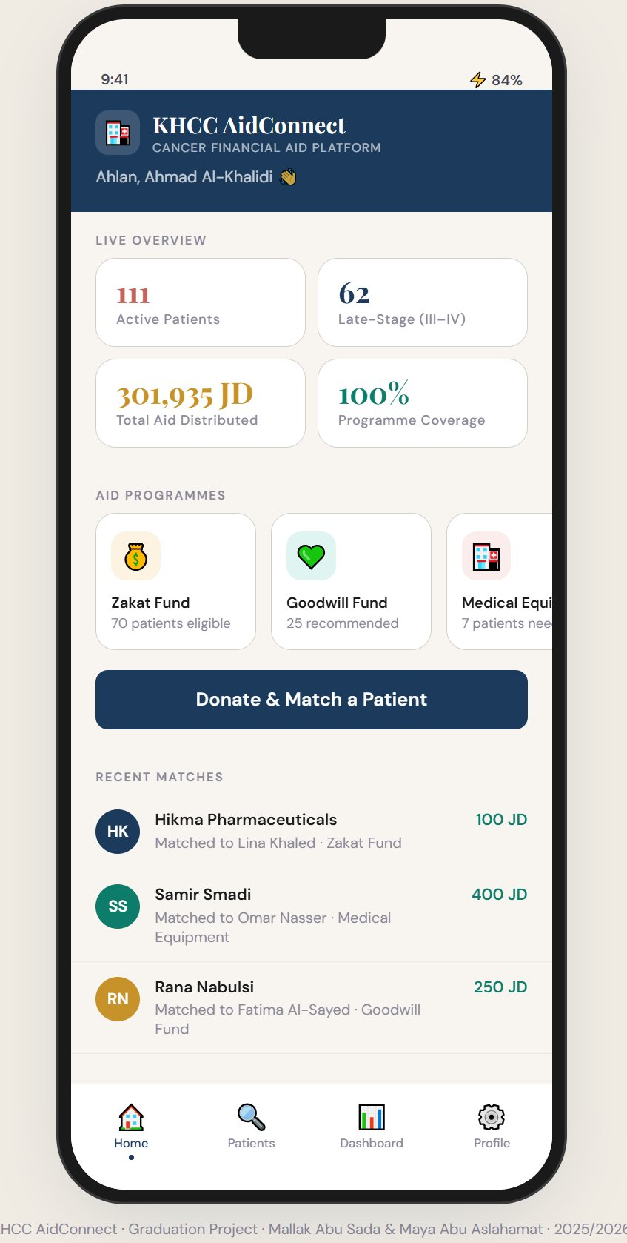
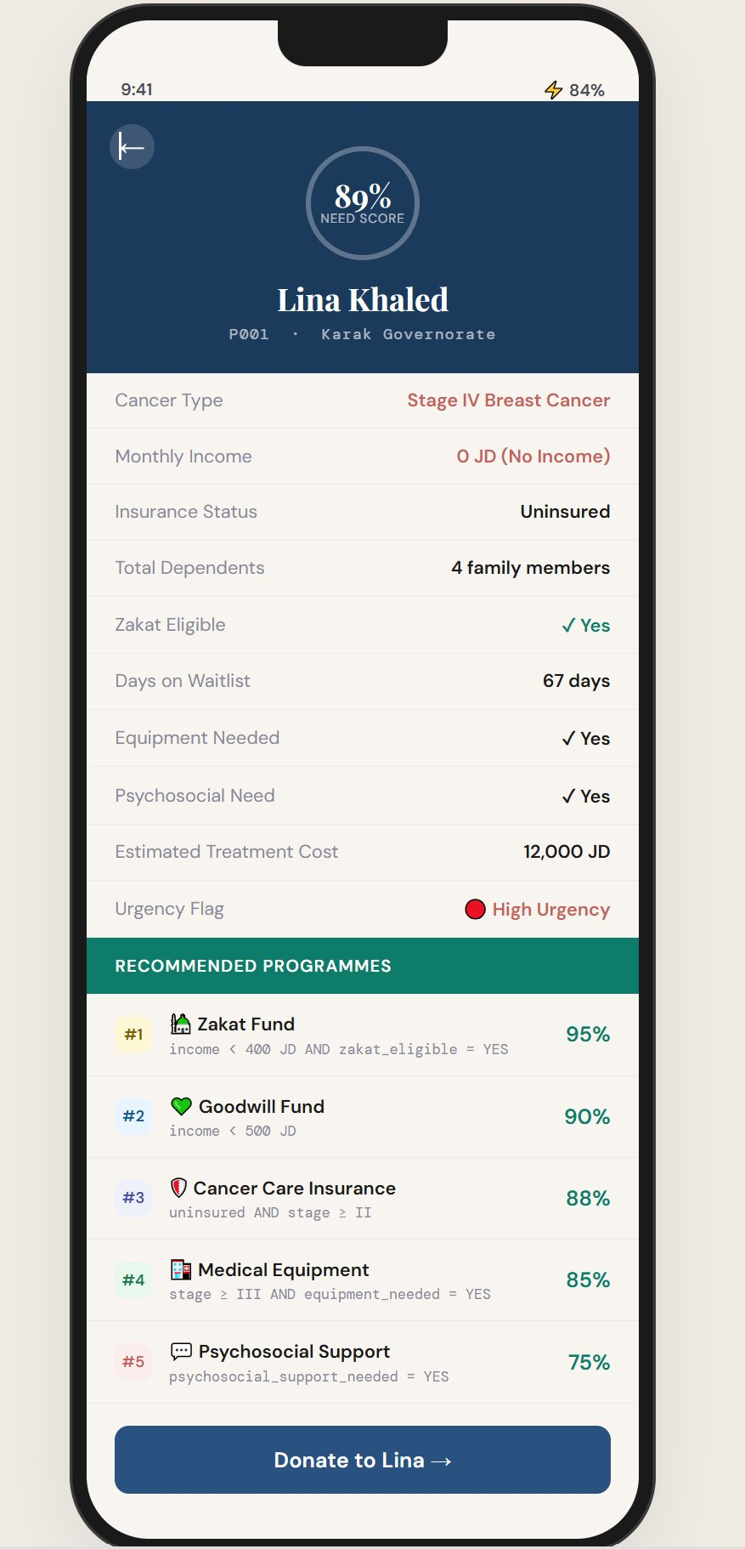
See It In Action: The App (1 of 2)
SLIDE 4 / 15
A donor opens it and instantly sees who needs help. Two taps to the right patient.
1. Home
2. Match
The donor sees live need the moment they open the app: how many patients are waiting, total aid given, and a clear button to start giving.
One tap runs the KNN engine and returns the four most compatible patients, ranked, each with a similarity score and a best match badge.
KHCC AidConnect · Graduation Project Defense · Mallak Abu Sada & Maya Abu Aslahamat · 2025/2026

Slide 5
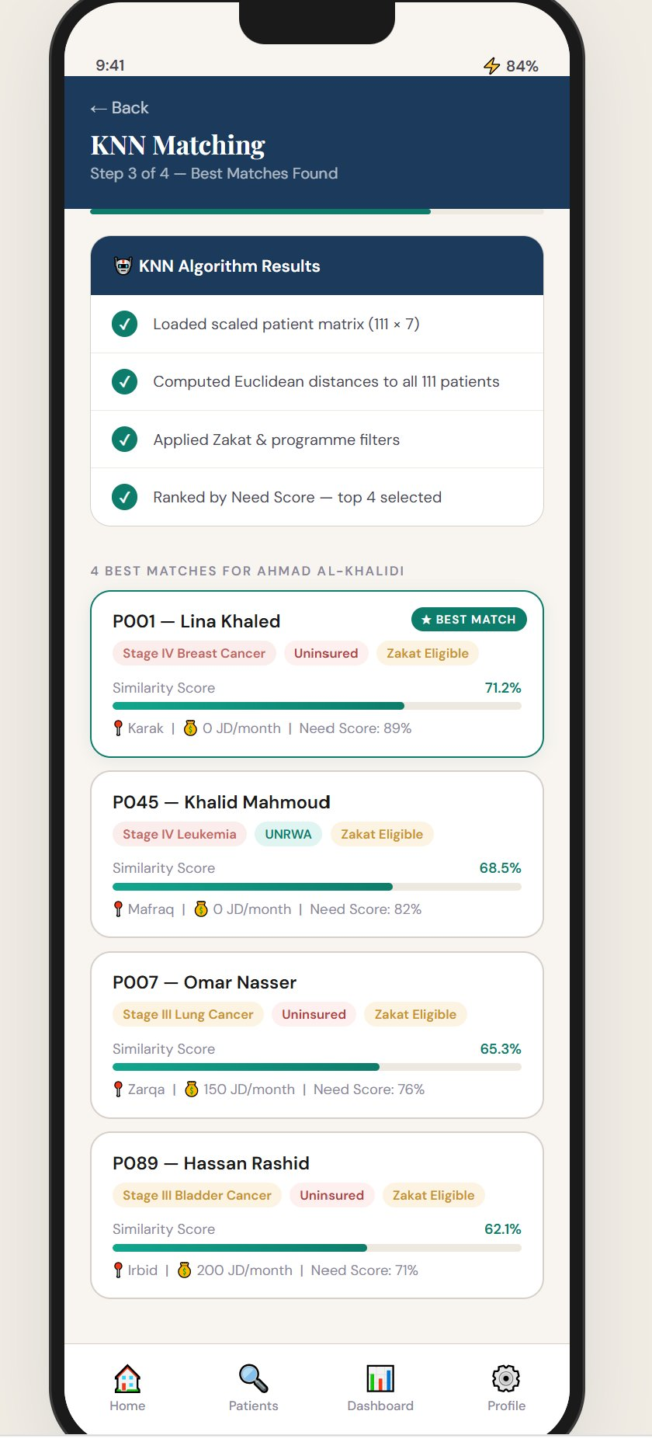
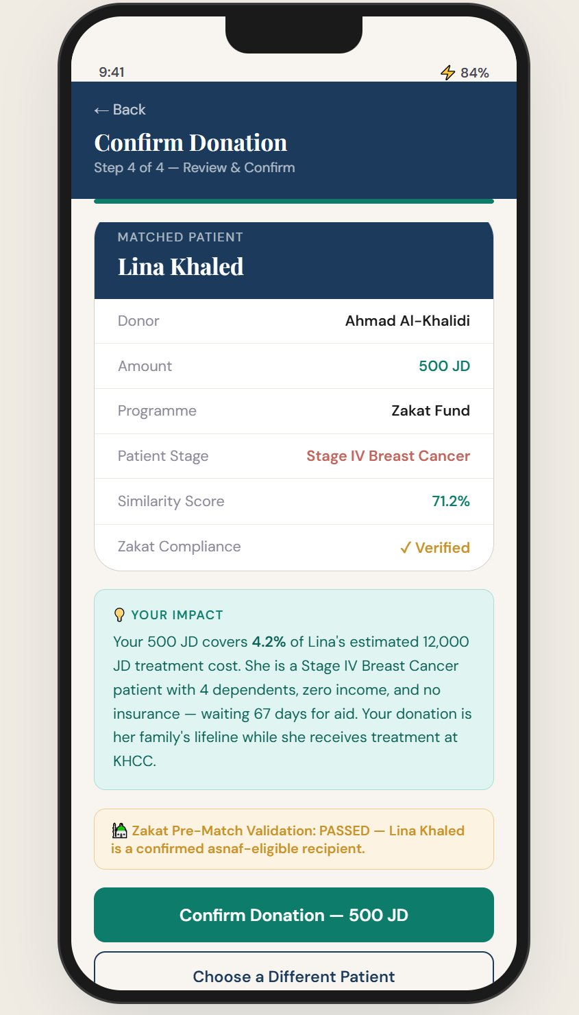
See It In Action: The App (2 of 2)
SLIDE 5 / 15
The donor reads the full story, confirms, and sees their exact impact, with Zakat checked.
3. Patient
4. Confirm
The donor sees the patient clearly: cancer type and stage, income, dependents, recommended programmes, and a transparent need score. The full story, nothing hidden.
At confirmation the Zakat gate runs. The donor gets a personal impact line, your gift covered 4.2% of treatment, and a verified compliance stamp.
KHCC AidConnect · Graduation Project Defense · Mallak Abu Sada & Maya Abu Aslahamat · 2025/2026

Slide 6
Aims & Objectives
SLIDE 6 / 15
Our goal: make KHCC aid fairer, faster, and more transparent, without taking the human out of the decision. Eight objectives, all achieved.
1
Need Score
2
KNN Engine
3
Recommender
4
Zakat Gate
A fair, weighted score validated by statistics
Retrieve the 4 most similar patients in real time
Six rules, a ranked programme list for everyone
Block non compliant gifts before they happen
5
Transparency
6
Dashboards
7
The App
8
Clean Pipeline
A personal impact message for every donor
Four Tableau views for four audiences
A full donor journey from home to thank you
Reproducible from raw data to deployment
KHCC AidConnect · Graduation Project Defense · Mallak Abu Sada & Maya Abu Aslahamat · 2025/2026

Slide 7



Methodology: Built on Data We Trust
SLIDE 7 / 15
A Jordan calibrated dataset, three linked tables, prepared with care before any model was built.
111 Patients
250 Donors
378 Matches
27 fields: stage, income, dependents, waitlist, Need Score
19 fields: type, preferred fund, amount, Zakat only flag
10 fields: who gave, how much, which fund, outcome
How we prepared it
1
Clean
2
Encode
3
Scale
4
Split
174 missing values filled with meaning, zero duplicates
Stage ordered 1 to 4, Yes or No turned into 1 or 0
All 7 features set to 0 to 1 so none can dominate
70% to train the engine, 30% held back to test it
KHCC AidConnect · Graduation Project Defense · Mallak Abu Sada & Maya Abu Aslahamat · 2025/2026

Slide 8
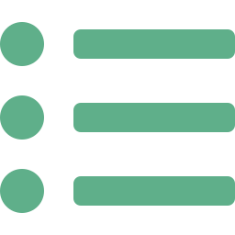

How the Engine Works
SLIDE 8 / 15
Behind the app are two clear components. One finds the right patients, one picks the right programmes. A compliance gate sits between them.
KNN Matching Engine
Programme Recommender
Uses 7 patient features and Euclidean distance to surface the 4 most compatible patients for any donor, instantly. Precision@4 of 1.00.
Six clear eligibility rules give every patient a ranked, confidence scored list of aid programmes. 100% coverage, fully explainable.
Zakat Compliance Gate Before any restricted gift is confirmed, the system checks it is Sharia compliant. If not, the match is blocked and a certificate is issued for every valid one.
KHCC AidConnect · Graduation Project Defense · Mallak Abu Sada & Maya Abu Aslahamat · 2025/2026

Slide 9

Results: The Numbers Prove It Works
SLIDE 9 / 15
1.00
100%
3 / 3
Precision@4
Coverage
Tests Passed
Target was 0.75. Every patient the engine returned was clinically relevant.
All 111 patients received at least one recommended programme.
All hypothesis tests confirmed the Need Score is statistically sound.
What the tests showed
Stage drives need
Income drives need
Two separate signals
Late stage patients score far higher (p < 0.0001)
Strong negative link, r = -0.69
Zakat need and urgency are independent (p = 0.77)
KHCC AidConnect · Graduation Project Defense · Mallak Abu Sada & Maya Abu Aslahamat · 2025/2026

Slide 10
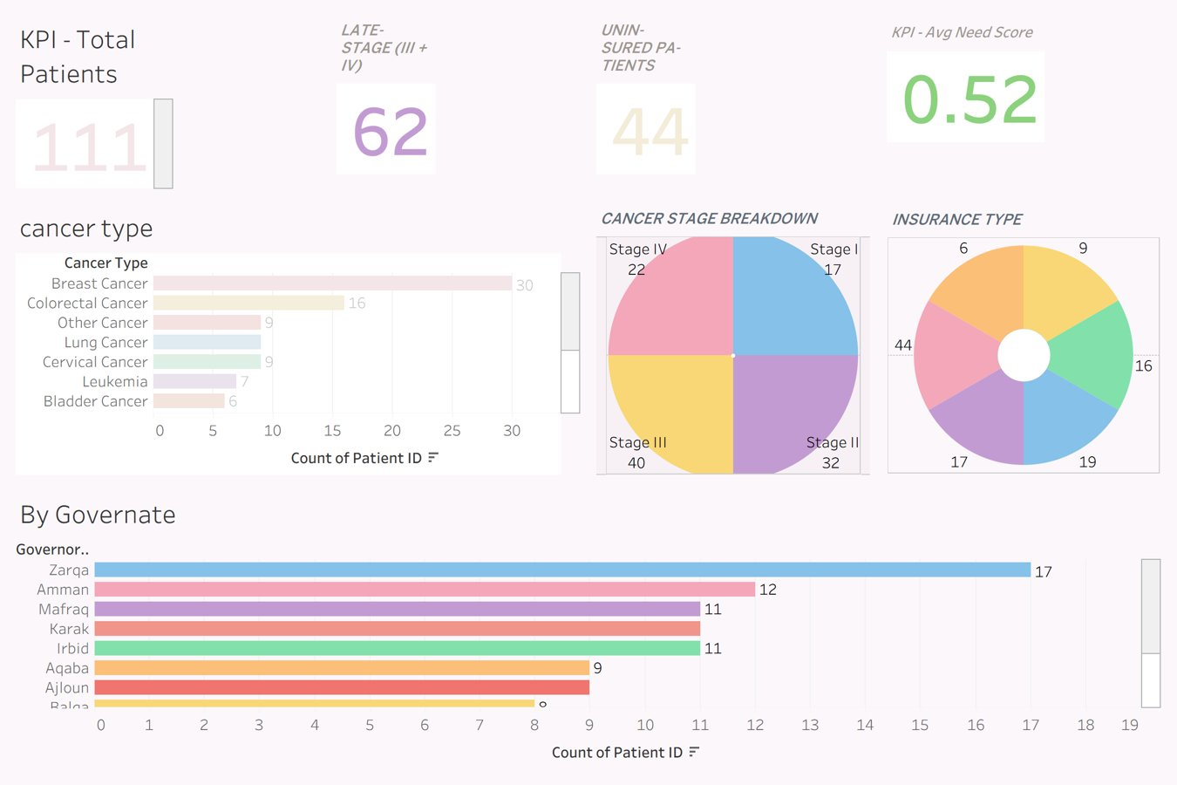
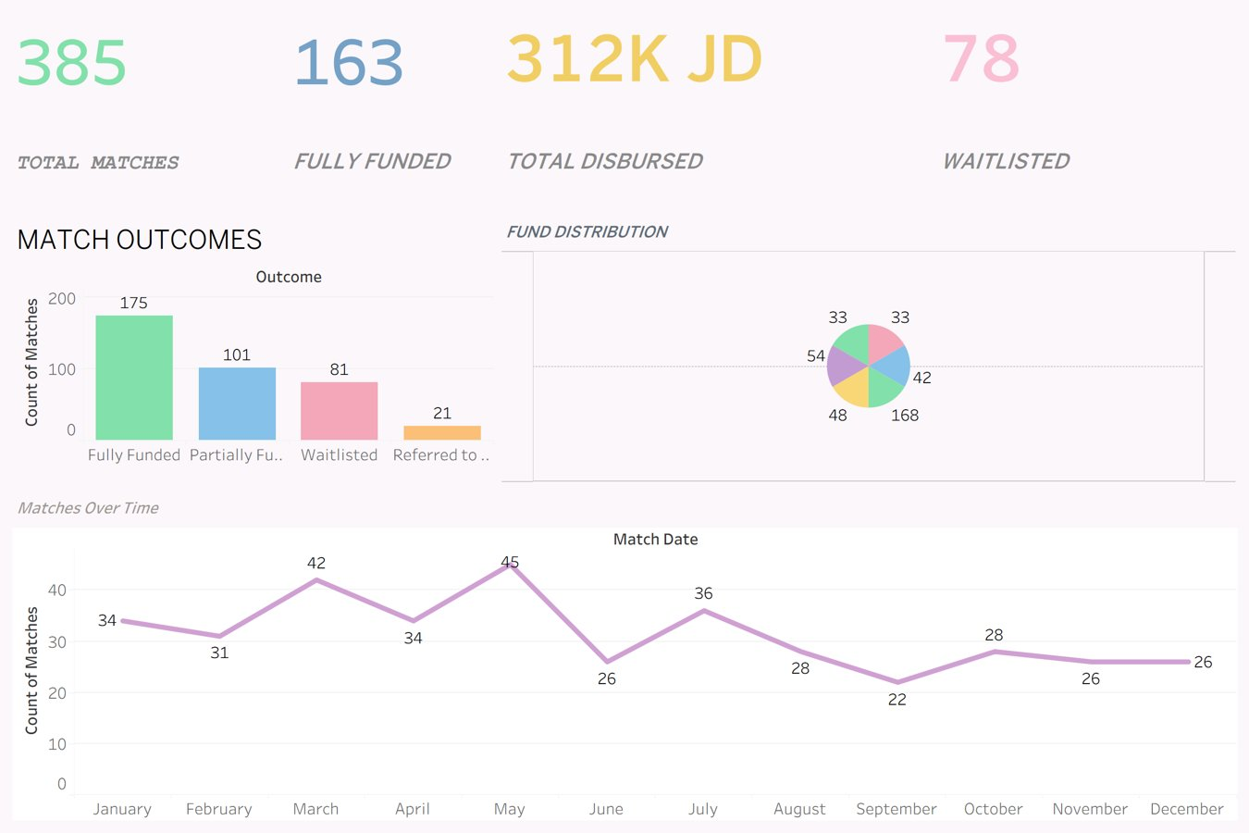
Business Intelligence: Dashboards (1 of 2)
SLIDE 10 / 15
Every finding becomes live, interactive insight. Each dashboard answers one question for one audience.
Patient Need
Match Outcomes
For caseworkers: who needs help, how urgently, and where they live.
For leadership: how much was funded, disbursed, and still waiting.
KHCC AidConnect · Graduation Project Defense · Mallak Abu Sada & Maya Abu Aslahamat · 2025/2026

Slide 11
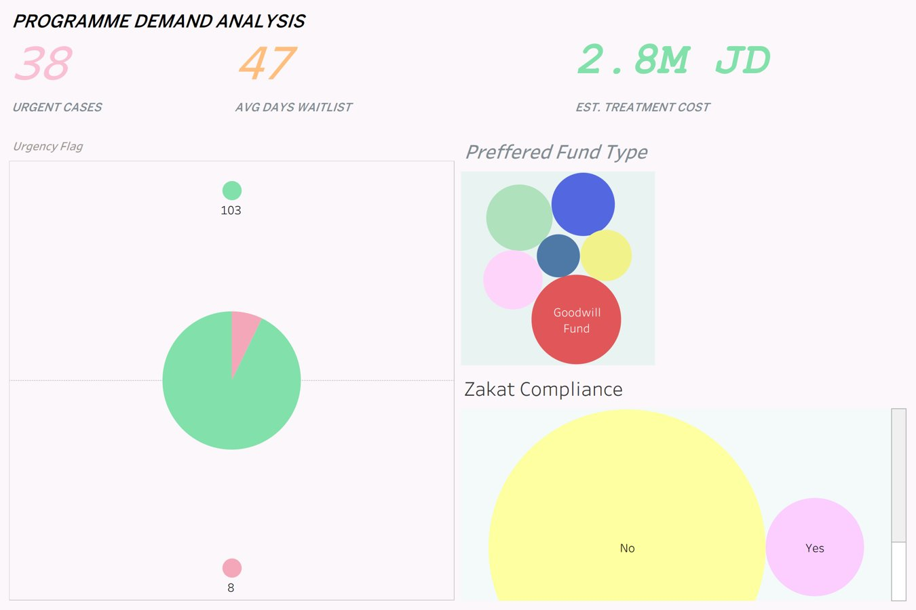
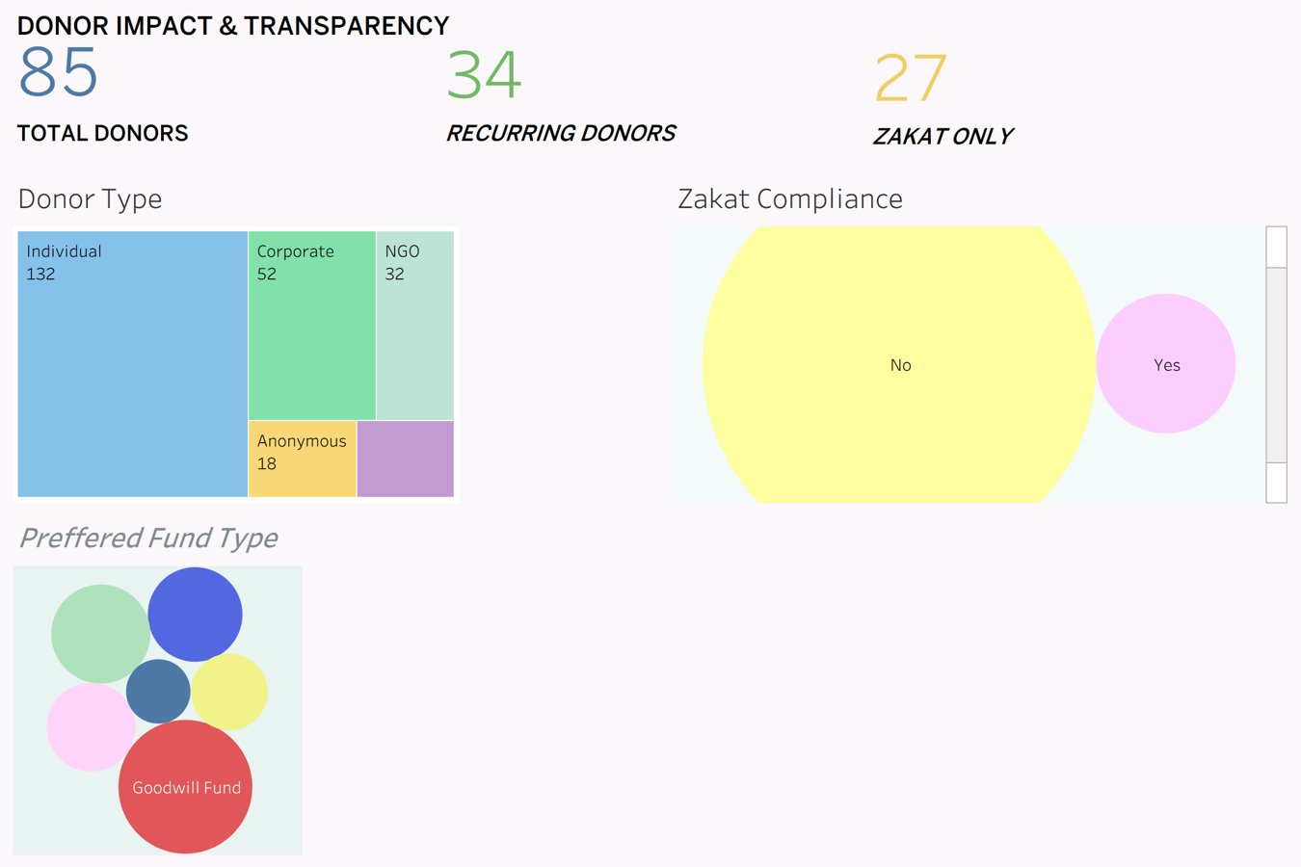
Business Intelligence: Dashboards (2 of 2)
SLIDE 11 / 15
All four are cross filtered, so one click updates the whole view for fast, confident decisions.
Programme Demand
Donor Impact
For planning: which funds carry the heaviest demand and cost.
For fundraising: giving, recurring donors, and Zakat compliance.
KHCC AidConnect · Graduation Project Defense · Mallak Abu Sada & Maya Abu Aslahamat · 2025/2026

Slide 12

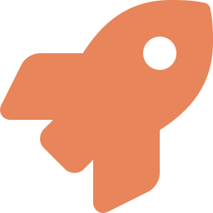

Future Work: Where We Take It Next
SLIDE 12 / 15
Live hospital data
Smarter matching
Donor retention
Connect to KHCC records so the Need Score updates itself, with no manual entry.
Move from KNN to a learning model that improves from every match over time.
Predict which recurring donors may lapse and reach out before they do.
Full Arabic interface
Nationwide rollout
Private by design
A bilingual app so every donor in Jordan can use it with ease.
The pipeline is institution agnostic, ready to scale across Jordan.
Train across hospitals without ever sharing raw patient data.
KHCC AidConnect · Graduation Project Defense · Mallak Abu Sada & Maya Abu Aslahamat · 2025/2026

Slide 13

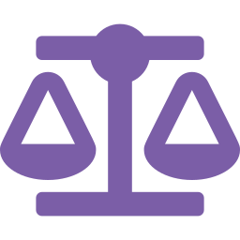
Conclusion: What We Delivered
SLIDE 13 / 15
We did not stop at a model. We built a complete, working solution with a real human purpose.
We built a real app
We proved it works
A working, mobile first donor journey from raw Excel to a deployed system.
Precision@4 of 1.00, 100% coverage, and three passing statistical tests.
We protect Zakat
We made it fair
Historically, 95.5% of restricted gifts were non-compliant. Our gate corrects this to 0%, so every Zakat gift reaches an eligible patient.
Every patient judged by the same formula, no matter who reviews the file.
KHCC AidConnect · Graduation Project Defense · Mallak Abu Sada & Maya Abu Aslahamat · 2025/2026

Slide 14
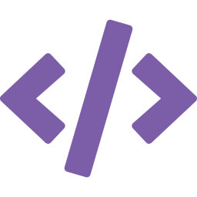

Deliverables: Documented and Ready
SLIDE 14 / 15
The full project is complete, version controlled, and reproducible end to end.
Code & Notebooks
Report & Assets
Notebooks 01 to 06, fully run
patients_clean.csv (111 x 27)
donors_clean.csv (250 x 19)
matches_clean.csv (378 x 10)
The AidConnect web app
README and requirements
Full written report
Tableau workbook, four dashboards
This presentation
All charts and screenshots
The Jordan calibrated dataset
Signed supervisor cover page
KHCC AidConnect · Graduation Project Defense · Mallak Abu Sada & Maya Abu Aslahamat · 2025/2026

Slide 15
شُكراً
Thank You
We would love to hear your questions.
Mallak Abu Sada · Maya Abu Aslahamat | Supervised by Dr. Ayman M. Mansour | 2025 / 2026

